Slide 1
Heaps and Priority Queues
CS 580U Fall 2017

Slide 2
Priority Queue
When a collection of objects is organized by importance or priority, we call this a priority queue.
Instead of being a "First In First Out" or “Last In First Out” data structure, values come out in order of priority.
Every value is assigned a priority

Slide 3
Problem
Using data structures we’ve seen so far as a Priority Queue
Using an Array
sorted order makes insert slow, removePriority fast
arbitrary order makes insert fast, removePriority slow
Using a Linked List
Sorted makes insert slow
Unsorted makes removePriority slow
Using a BST
removePriority is log₂ of size IF the tree stays balanced
If the tree is not balanced, insert and removeMax can be slow.

Slide 4
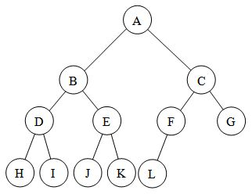
Balanced and Complete Trees
Balanced Tree
The tree’s height is as small as possible at all times
No leaf is more than one level away from any other leaf in the tree
Complete Tree
A tree in which every level, except the last, is filled, and all nodes are as far left as possible.

Slide 5
Solution
A balanced BST will give the best performance for a priority queue
More Problems:
Read operation only accesses a single value
Make read constant time by making the priority value the root
BST structure uses strict ordering
All values can only go one place which makes keeping the tree balanced difficult

Slide 6
Heap
A data structure that allows
partial ordering
always has the priority value as the root
A heap is:
a complete binary tree
nearly always implemented using the array representation
The values in the tree maintain a parent/child relationship only.
No defined relationship with the tree as a whole
This is called partial order

Slide 7
Array Based Tree
Mapping elements of a tree into an array
if a node is stored at index k
the left child is at index 2k+1
The right child is at index 2k+2
The parent is (K-1)/2
Assertion: Maintaining a balanced tree is easier with an array based implementation.
Agree?
Don’t confuse the logical representation of a heap (tree) with its implementation (array).
Notes:
Can iteratively search through the tree for empty indexes

Slide 8
Heap Variants
There are two variants of the heap
In a max heap, every node stores a value that is greater than or equal to the value its children.
Because the root has a value greater than or equal to its children, which have values greater than or equal to their children, the root stores the maximum of all values in the tree.
In a min heap, every node stores a value that is less than or equal to that of its children.

Slide 9
Node Relationships
There is no relationship between the value of a node and that of its sibling in a heap
For example, the values for all nodes in the left subtree of the root could be greater than the values for every node of the right subtree.
This is a feature, not a bug
Contrast with a BST which has a strict ordering relationship

Slide 10
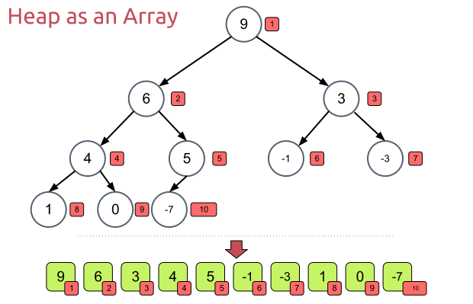
Creating A Heap
Given an array of N values, a heap can be built by “sifting” each node down to its proper place
Any array can be made into a heap using the ‘Heapify’ sorting algorithm

Slide 11
Where to Start?
9
Start with the last internal node
How do we find the last internal node (non-leaf)?
Take the last index, then find parent: (i-1)/2
Swap the current internal node with its smaller child, if necessary
6
3
4
5
-1
-3
1
0
-7

Slide 12
Sift Down
Follow the swapped node down the tree until both children are larger
9
9
6
3
6
3
4
5
-1
-3
4
-7
-1
-3
1
0
-7
1
0
5

Slide 13
Sift Down
Go to the next internal node. Repeat until all internal nodes are done
Check both children for the smaller value
9
9
6
3
6
3
4
-7
-1
-3
0
-7
-1
-3
1
0
5
1
4
5

Slide 14
the Heap Instance Variables
// Min-heap implementation struct MinHeap{ Data * heap; //Pointer to an array of comparables int n; // Number of things now in heap
int max; //maximum size of the heap
…

Slide 15
Constructing the Heap
Constructor supporting preloading of heap contents
Heap * initMinHeap(Data * h, int num, int max){ Heap * heap = malloc(sizeof(Heap)); heap->n = num; heap->size = max; heap->heap=h; buildheap(heap); //creates the heap data structure return heap; }

Slide 16
Constructing an Array Based heap
Though not required, you should have functions that return pointers to parents and children
int left(i){ if(2i + 1 > n) return -1; else return 2i + 1; }

Slide 17
Heapify
//Heapify the array elements
void buildheap(Heap * h){ for (int i=(h->size-2)/2; i>=0; i--) siftdown(h->heap, i); }
Why is ‘i’ initialized like this?
Because size is 1 more than the last index of the array
Buildheap will run through (almost)every element of the array

Slide 18
SiftDown
// Put element in its correct place
void siftdown(Data * heap, int pos) { if ((pos < 0) || (pos >= n)) return; // Illegal position while (!isLeaf(pos)){ //Keep swapping until you get to a leaf int j = left(pos); //Get left child if ((j+1 < n && (heap[j] > heap[j+1])) j++; // j is now index of child with greater value if (heap[pos] < heap[j]) return; else swap(heap[pos], heap[j]); pos = j; // Move down } }

Slide 19
Removing the Priority Value
What happens when we remove the priority value?
The priority value is stored at the root
Choose the last leaf to replace the root, then sift down
Why choose the last leaf?
Comparable removePriority(Heap * h){
//Check for empty heap
if (numVertices == 0)
return ;
//Swap the root with last leaf
Comparable priority = heap[0];
h->heap[0] = h->heap[n - 1]; h->heap[n - 1] = priority;
//shrink heap by one node n--;
//sift new root down
siftDown(0);
return priority;
}
Notes:
Choosing the last leaf allows you to call siftDown which only requires logn swaps. Choosing another node would require you to call sift down on it and all it’s children.
Choosing the last node guarantees it is a leaf node.

Slide 20
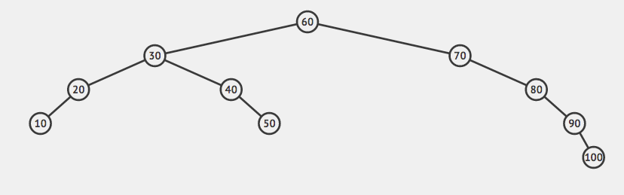
Classwork
From BST to Heaps

